Slide 1
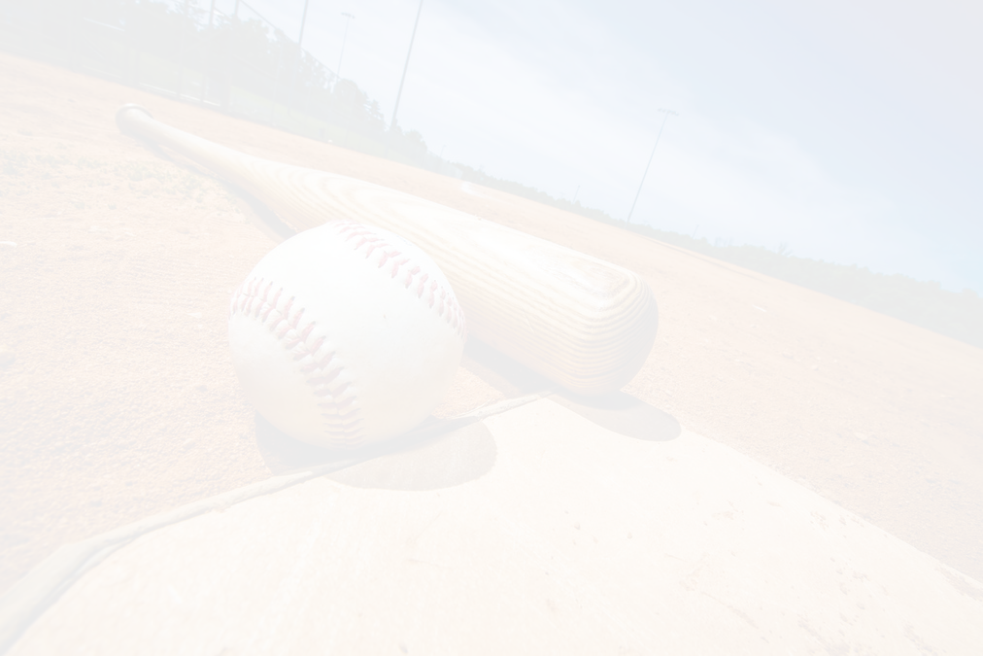
How To Register

Slide 2
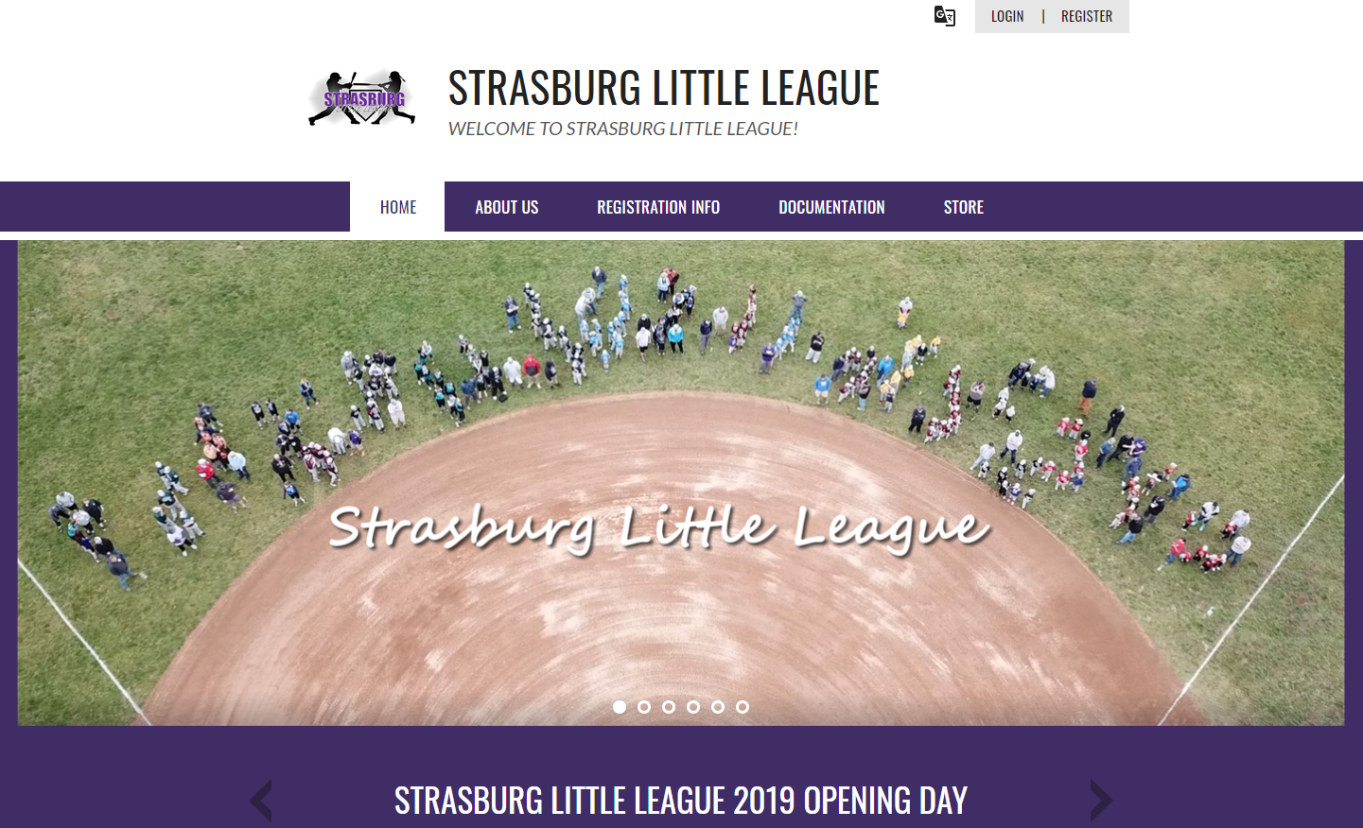
Click Here to Register!

Slide 3
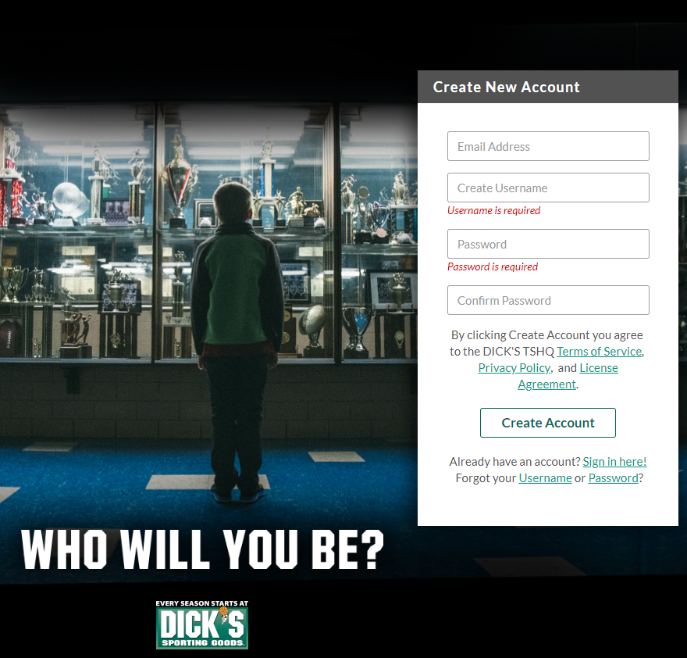
Create your Username and Password that will be associated with your email address / account.

Slide 4
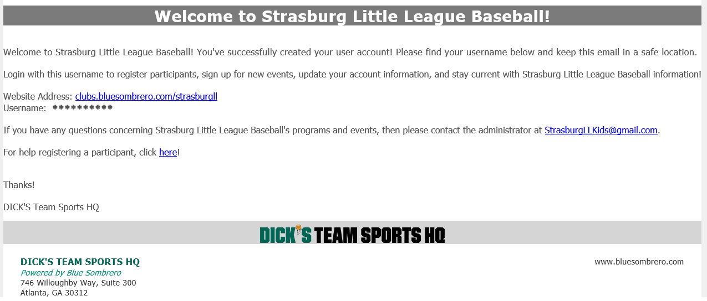
You will receive the below email as soon as you create your account

Slide 5
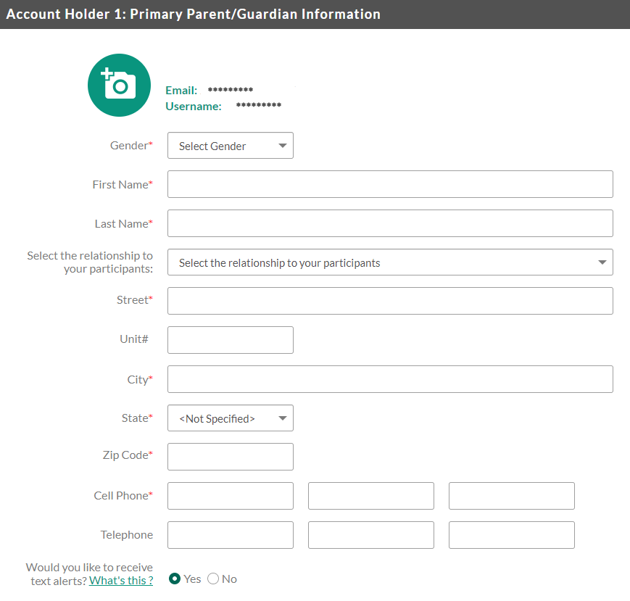

On the site, you will be directed to create your parent portal account. This will be the account of the parent / guardian.
You will also be able to add a 2nd account holder towards the bottom of the page. They will be automatically invited to the page by entering their data in the required fields and click on “Invite Account Holder & Continue” at the bottom of the web page.

Slide 6
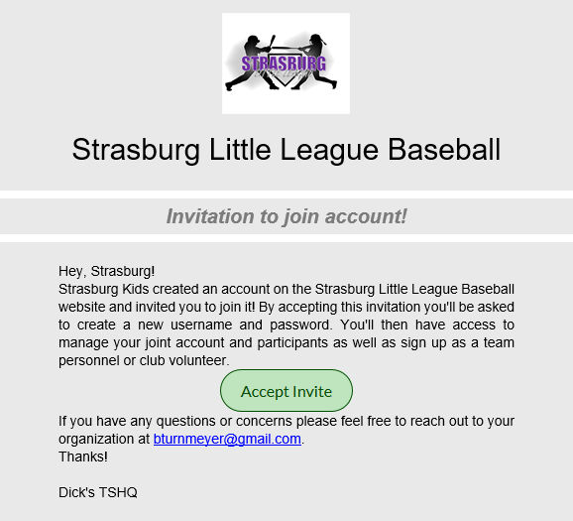
Here is an example of the email the 2nd account holder will receive with the invitation.

Slide 7
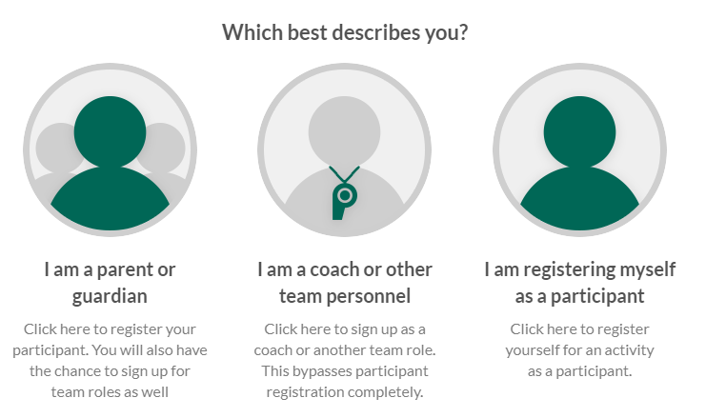
Select which best describes the reason for you to sign up.

Slide 8
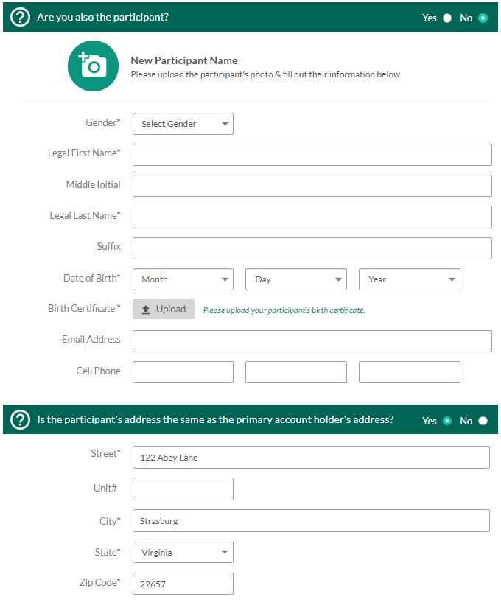

If you signed up as a parent or legal guardian, then you will be directed to “New Participant Information” (shown to the right).
Fill in your child’s information. If adding multiple children, click on +New Participant at the bottom. If registering one child, click on Continue.
***Note***
You must attach a copy of the child’s birth certificate to this screen in order to continue.

Slide 9
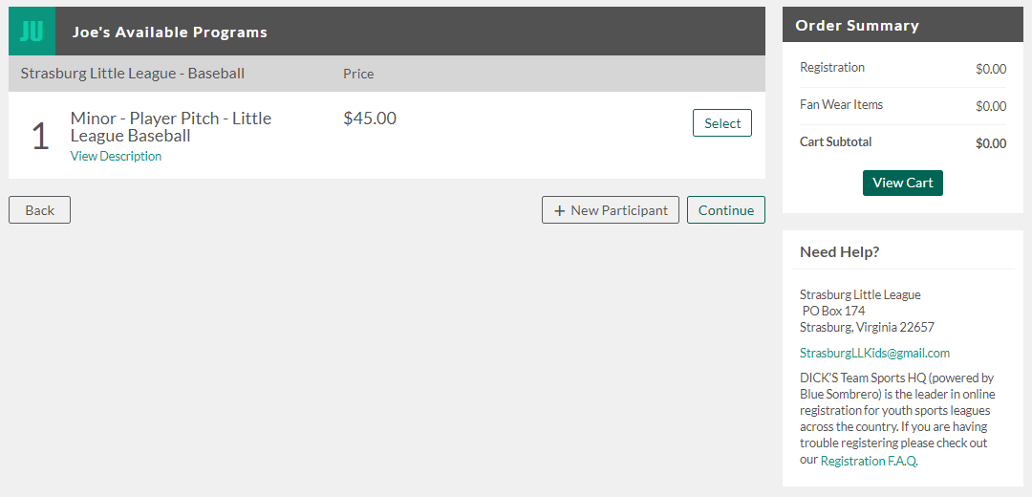
Next you will need to choose the Program Information. Based on the child’s age you selected and their birth certificate, you could see multiple options here or just one. In this case, Joe User was born on Feb 1, 2010 and is only eligible to play in Minor – Player Pitch Little League Baseball.
***Note*** Players can play up but will need to be changed by an admin.
Select the Division and then click Continue

Slide 10
Next you will be instructed to answer a few questions. Those include the following:
Little League Name?
Does Your Child Play Travel Ball?
Did You the Parent Play Little League as a Kid?
Accept the Little League Privacy Policy?
Whether the child is New or Returning player?
Medical Release Form (must be filled out and attached)?
School?
Current Grade?
Coach Request (Not Guaranteed)?
Accept the Player Verification Waiver?
Jersey Size?
Jersey Number Request (Not Guaranteed)?
Volunteer Application (If volunteering)?
Proof of Residency?
School Enrollment?

Slide 11
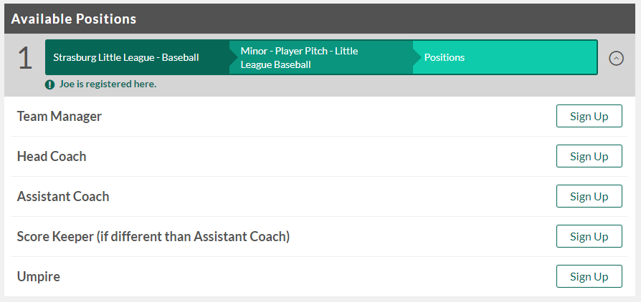
If you filled out the Volunteer Application, then the next screen is where you will sign up to Volunteer. It will automatically direct you to the place your child is located. In the example below Joe User is already registered in Minor Player Pitch, so the parent or Legal Guardian can sign up to volunteer here.
If you are not signing up to volunteer, check the box at the bottom next to Continue

Slide 12
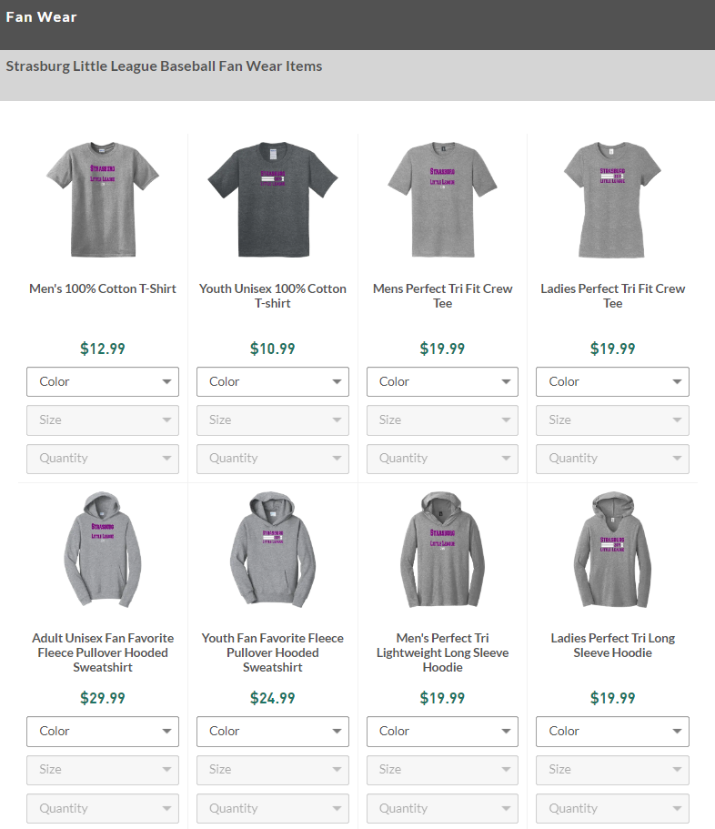
Next you will be directed to the Fan Wear store that has been set up for Strasburg Little League. Parents, Coaches, and fans will all be able to purchase their own Strasburg Little League gear. 10% of the proceeds will be donated back to Strasburg Little League.

Slide 13
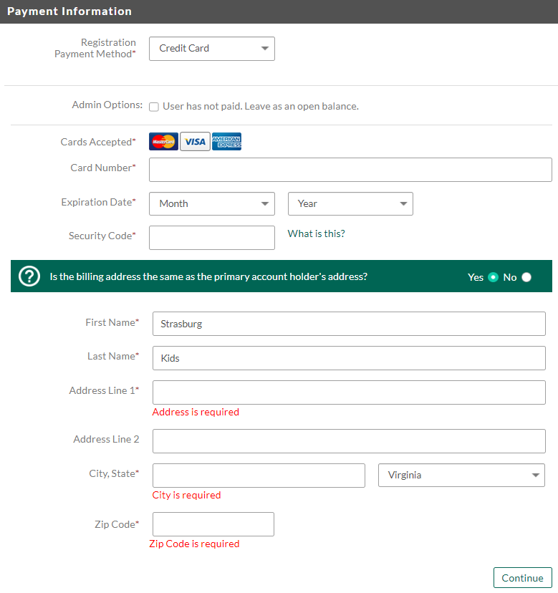
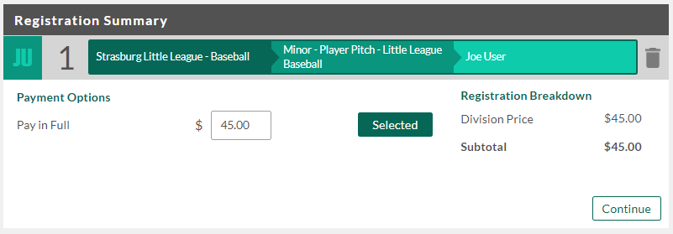
Next you will need to confirm your purchase and checkout. Checkout can now be done online and payments can now be collected via Credit Card or Debit card online.

Slide 14
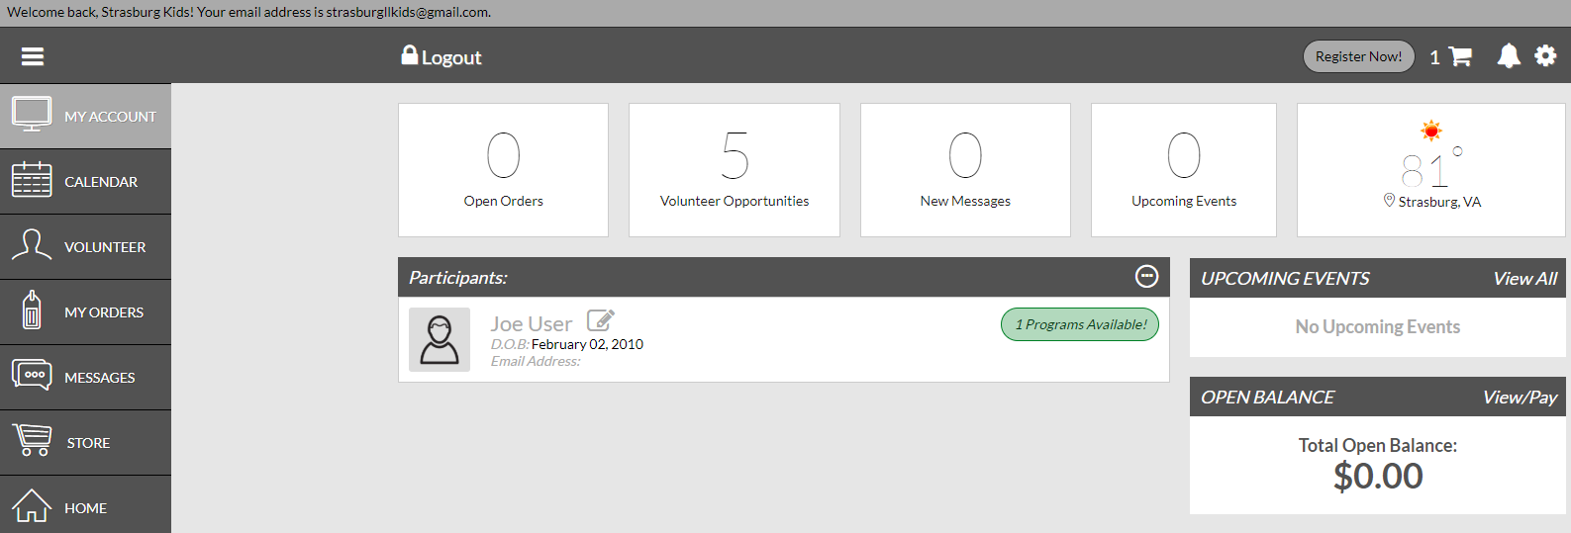
Below is a snapshot of the Parent Portal. From here you will be able to do just about everything you would need to do, including but not limited to:
View Your Account
Open Orders
Volunteer to Help
Little League Calendar
Messages
Visit the Strasburg LL Store
View Upcoming Events
Check the Weather
View your child’s / children’s registrations
Pay Remaining Balances
Set up Notifications
Much more!

Slide 15
Once registered, you will see listed under the Participants section in your account any data that will need to be submitted. You must fulfill all of these requirements before processing.

